Slide 1
Differential Binding
Tom Carroll
Rory Stark

Slide 2
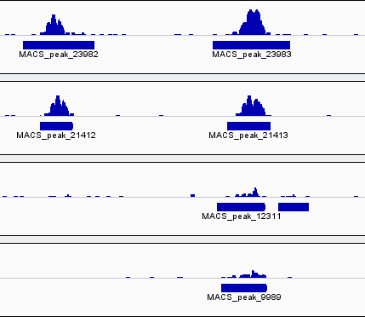
Occupancy Vs Affinity
Characterisation of binding is often qualitative.
But quantitative changes in binding at a site can have functional consequences.
Occupancy analysis can miss important changes between conditions.

Slide 3
Tools
Lots of tools to study changes in affinity
MAnorm (R-package)
ChIPDiff (R-package)
diffReps
DiffBind (R-package)
DBChIP (R-package)
dbPCA (R-package)

Slide 4
DiffBind
Written by Rory Stark and Gordon Brown
Leverages Rsamtools with statistics from EdgeR and DESeq to identify sites/peaks which are differentially bound between conditions.
Organised workflow to go from sample sheets to end results.

Slide 5
DiffBind Overview
Produce a set of consensus peaks.
Get counts within peaks across samples.
Correct read count in sample by input.
Normalise reads within samples (RNA-seq methods -- RLE or TMM).
Perform test of significance of change between groups (RNA-seq methods)

Slide 6
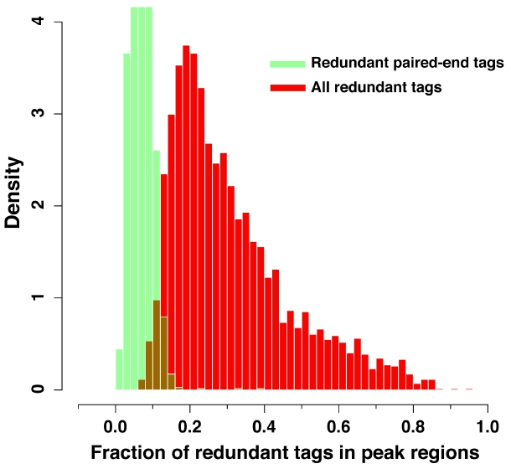
Duplicates and Differential Binding
Remember this ->
Removing duplicates can limit dynamic range.

Slide 7

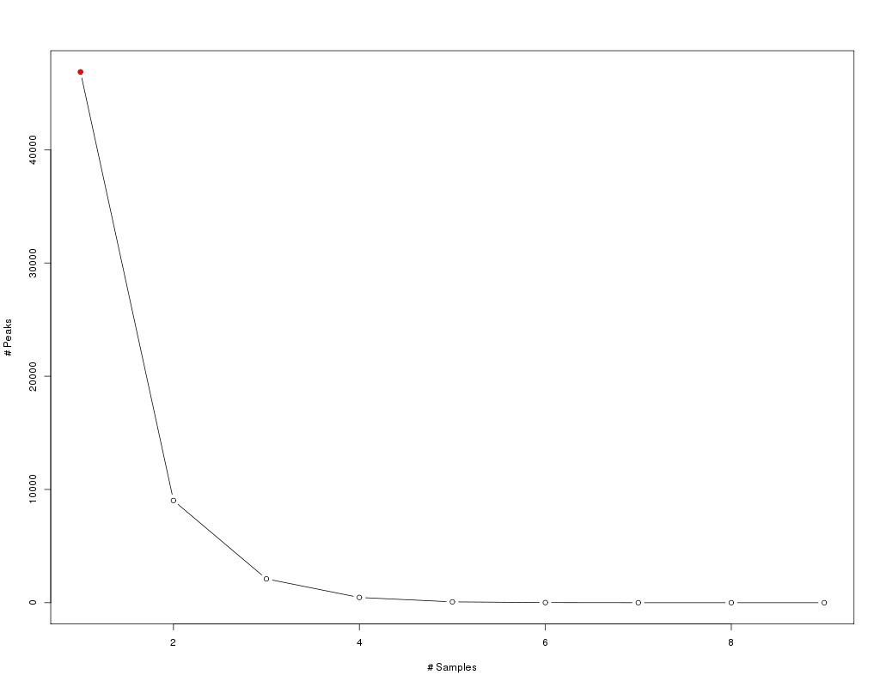
Making the consensus set
To make a consensus set of peaks we merge all peaks.
From the consensus sets we use occupancy/occurrence to identify peaks with consensus set to use.
E.g. Peaks in at least 2 out of 8 samples.
Take care with peaks used. If peaks are very long then consensus set will lose resolution.

Slide 8
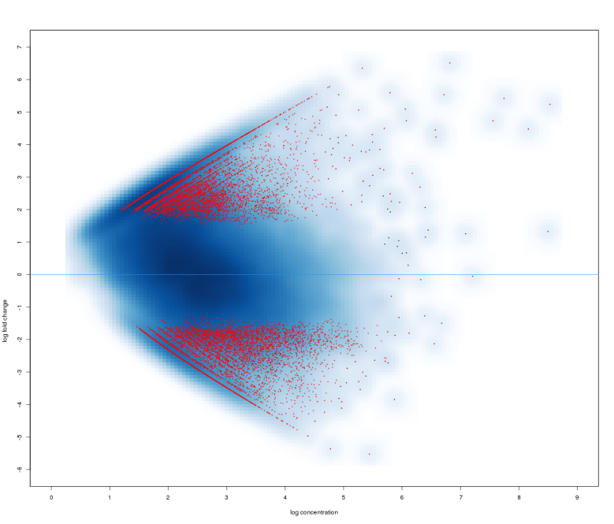
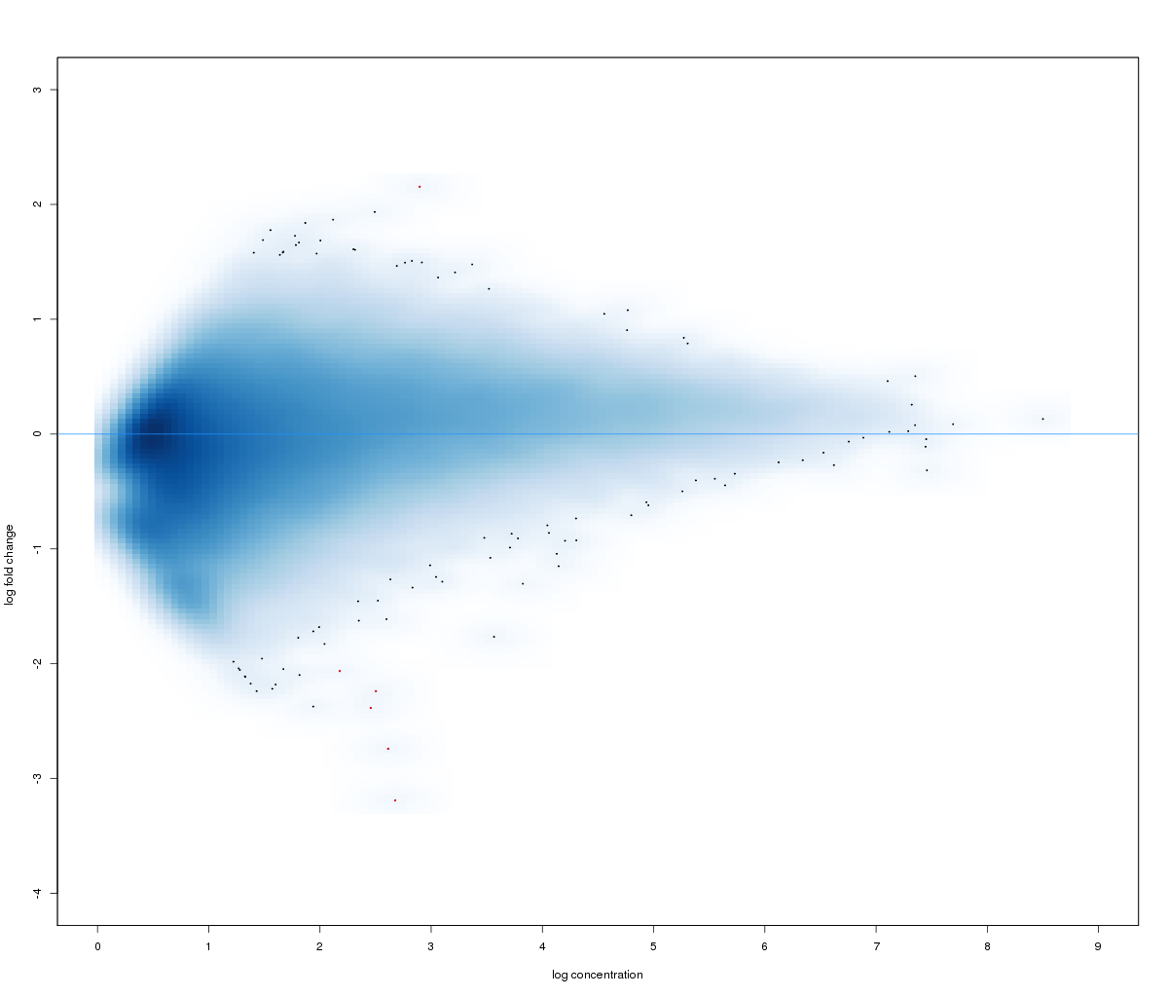
Counting and Normalisation
DiffBind applies RNA-seq methods to ChIP-seq.
So must ensure that same assumptions are met.
One important caveat is that overall there is no global change in ChIP signal.
Binding changes between tissues would work.
Changes after KO of TF wont!

Slide 9
Counting and Normalisation
Once counted and normalised we can then take advantage of other tools and plots typically used for RNA-seq/ microarray data.
Can be used for any non-overlapping genomic window. (TSSs/Enhancers
/SNPs)

